Slide 1
Inverse Laplace Transform

Slide 2
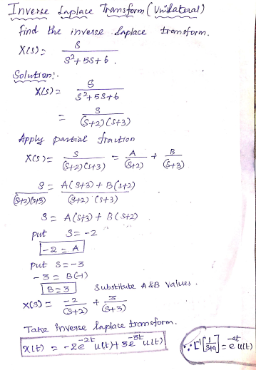

Slide 3
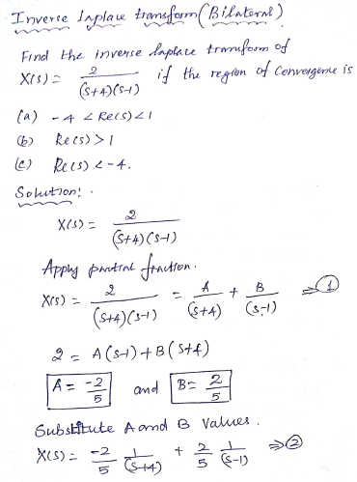

Slide 4
